Slide 1
NASA and Its Satellites

Slide 2
INTRODUCTION
NASA stands for National Aeronautics and Space Administration
Established in 1958 by the U.S. government
Responsible for space exploration, aeronautics research, and scientific discovery
Conducts missions to study Earth, the solar system, and the universe

Slide 3
What Does NASA Do?
Launches and manages satellites for Earth observation and communication
Explores planets and outer space through robotic missions
Conducts human spaceflight missions (e.g., International Space Station)
Advances technology for space and aviation
Shares scientific data with the world

Slide 4
Types of NASA Satellites
Earth observation satellites (e.g., Landsat)
Space telescopes (e.g., Hubble, James Webb)
Planetary probes and orbiters (e.g., MRO)
Communication and navigation satellites
Weather and climate monitoring satellites

Slide 5
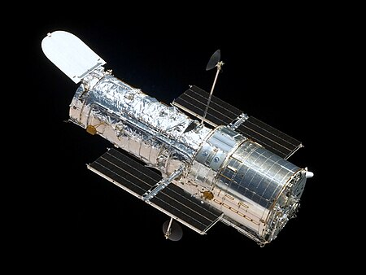
Hubble Space Telescope
Launched in 1990 by Space Shuttle Discovery
Orbits about 547 km above Earth
Capture images of stars, galaxies, and planets
Helped discover the age of the universe and
dark energy
Still operational after more than 30 years

Slide 6
Landsat: Earth Observation Satellite
Launched in 1972 to study Earth's land surface from space
They orbit Earth every 16 days, capturing high-resolution images
It uses multi-spectral sensors to record data in visible, infrared, and thermal bands
Scientists analyze the data to monitor land use, agriculture, forests, water, and climate change
The continuous data record helps track Earth’s changes over decades

Slide 7
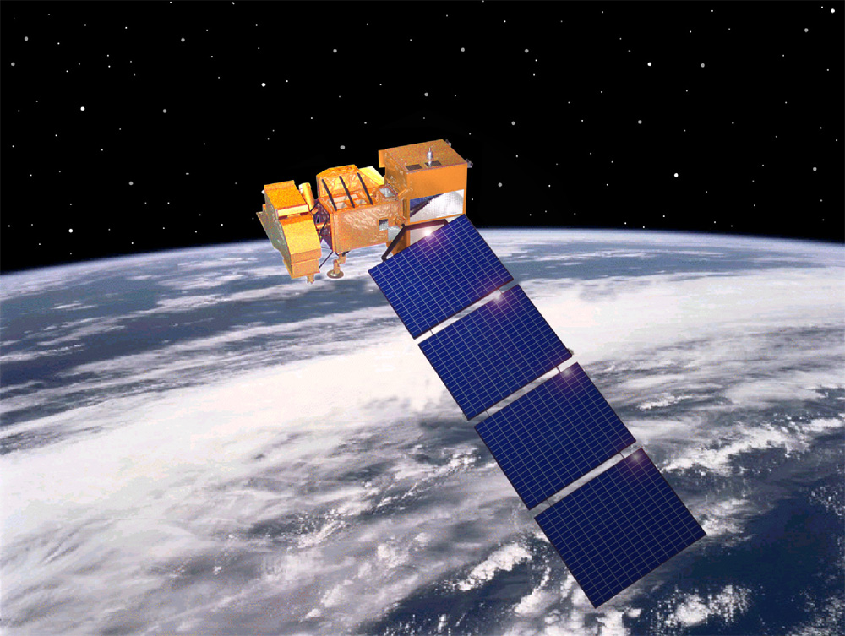
Landsat: Earth Observation Satellite

Slide 8
Mars Reconnaissance Orbiter (MRO)
MRO orbits Mars to study its atmosphere, surface, and subsurface.
It captures high-resolution images of the Martian surface.
Instruments analyze minerals, ice, and weather patterns.
MRO helps identify landing sites and monitors changes on Mars

